Slide 1


Slide 2

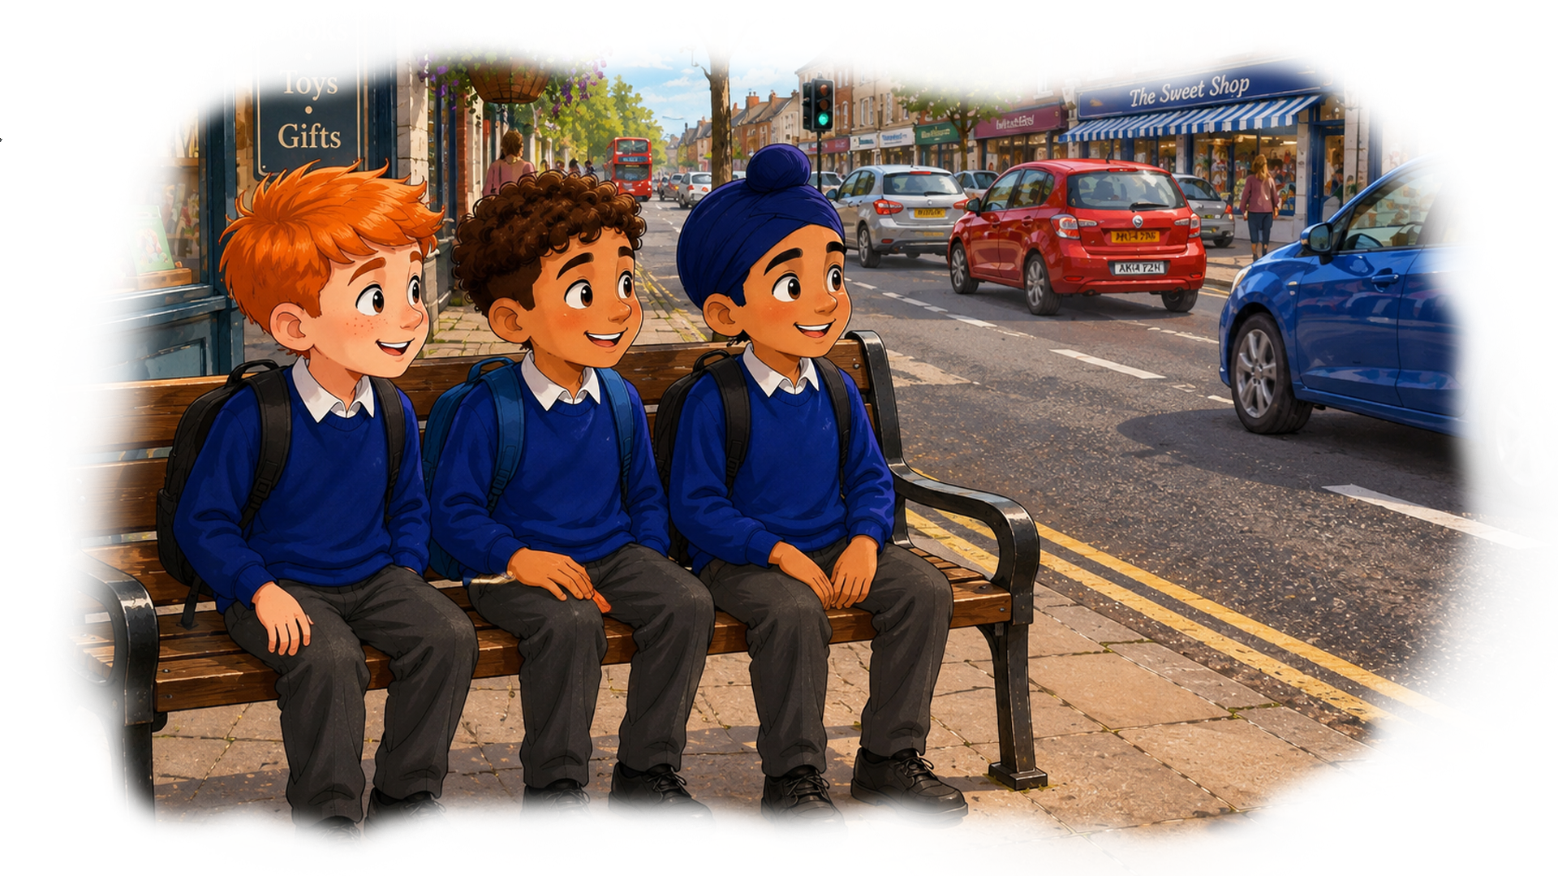
Watch out

Slide 3
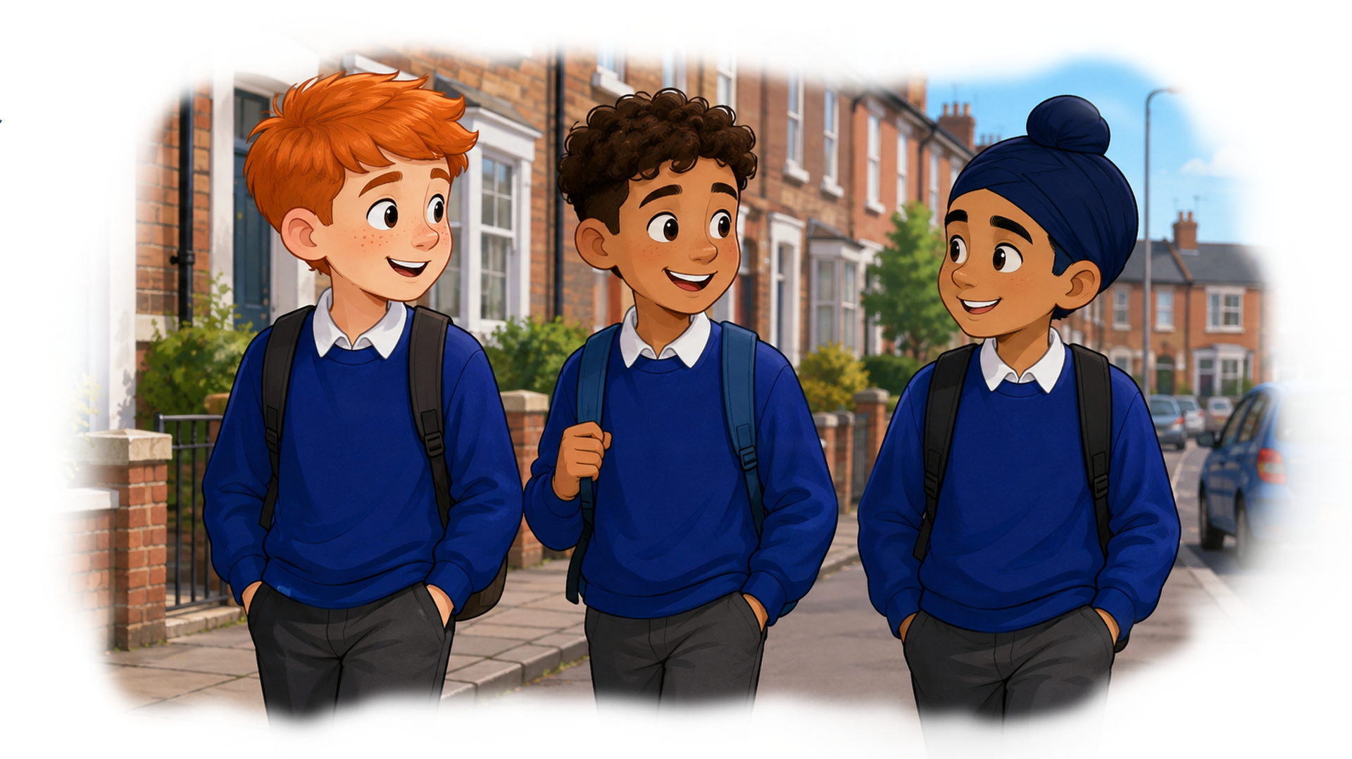
William, Anas, and Kiran are the best of friends.
They live near each other, and they walk to school together.
The boys are in the same class at school.

Slide 4
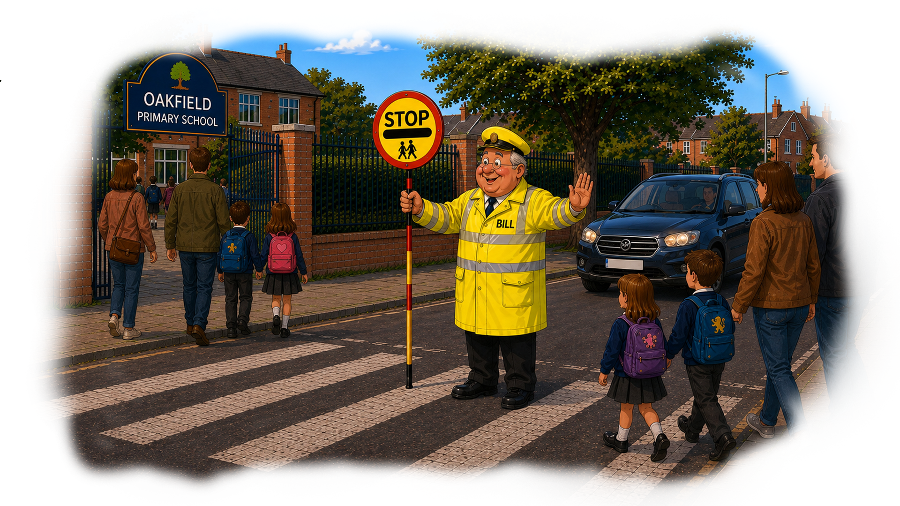
Their school is Oakfield Primary School, the school gate opens onto a busy road.
At the start and end of each day, Bill is there to help everyone cross the road safely.

Slide 5
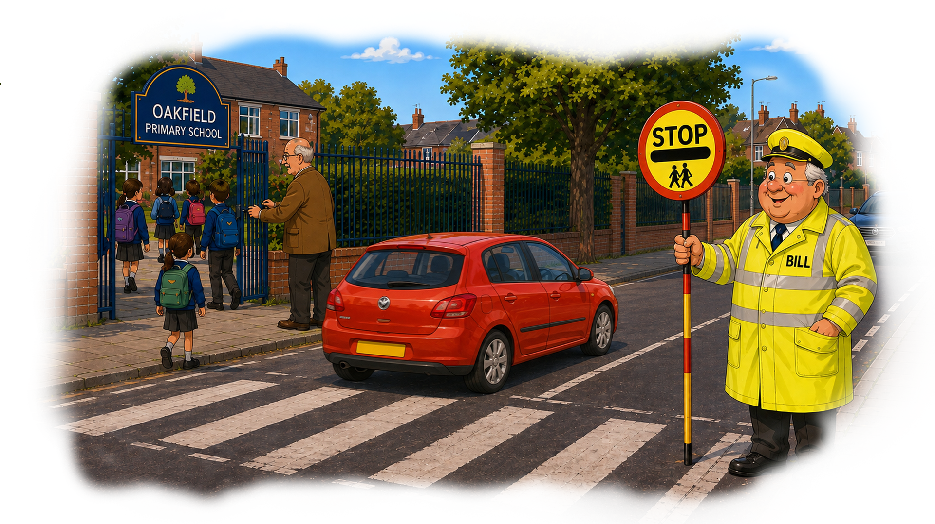
When the school bell rings, Bill waits till Mr Burns, comes out and closes the gate.
When he closes the gate, Bill’s job is done.
In the mornings, he looks forward to going home for a cup of tea and a piece of toast.

Slide 6
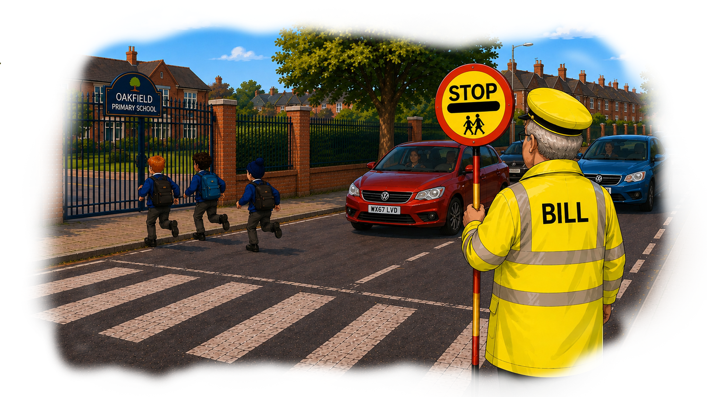
One day, as he walks away, he hears the screech of car brakes.
He turns round to see three boys running across the road.
The boys are late for school, and they have dashed across the road between the cars.
The drivers have had to brake quickly. Bill shouts “watch out!”

Slide 7
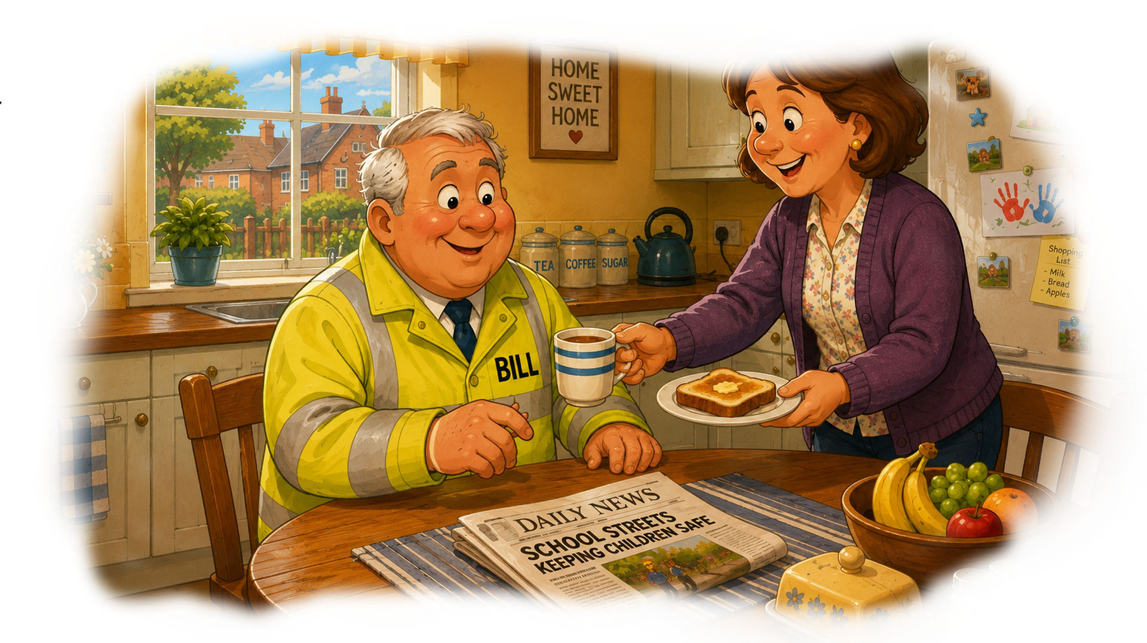
The boys are not hurt, they open the school gate, and run in. Bill is shaken.
He goes home, to a welcome cup of tea made for him by his wife, Judith.
As she hands him his cup of tea and piece of toast, he tells her what has happened.

Slide 8
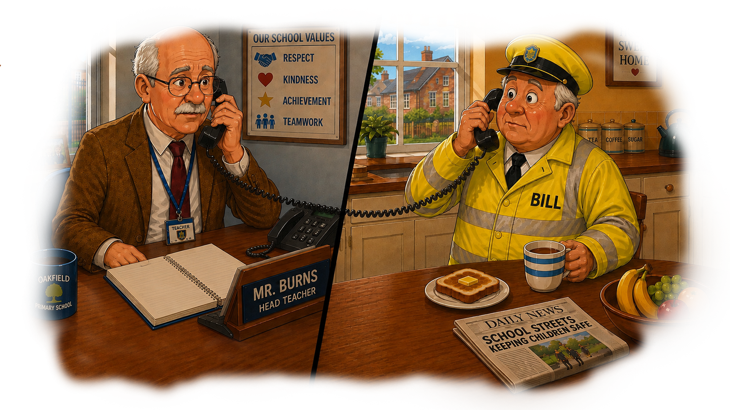
Bill rings the school. He tells Mr Burns that three boys, who were late for school,
ran across the road without looking, “they could have been knocked down by a car.”
The Headteacher says he will check the Lates Register and speak to the boys.
He thanks Bill for letting him know.

Slide 9
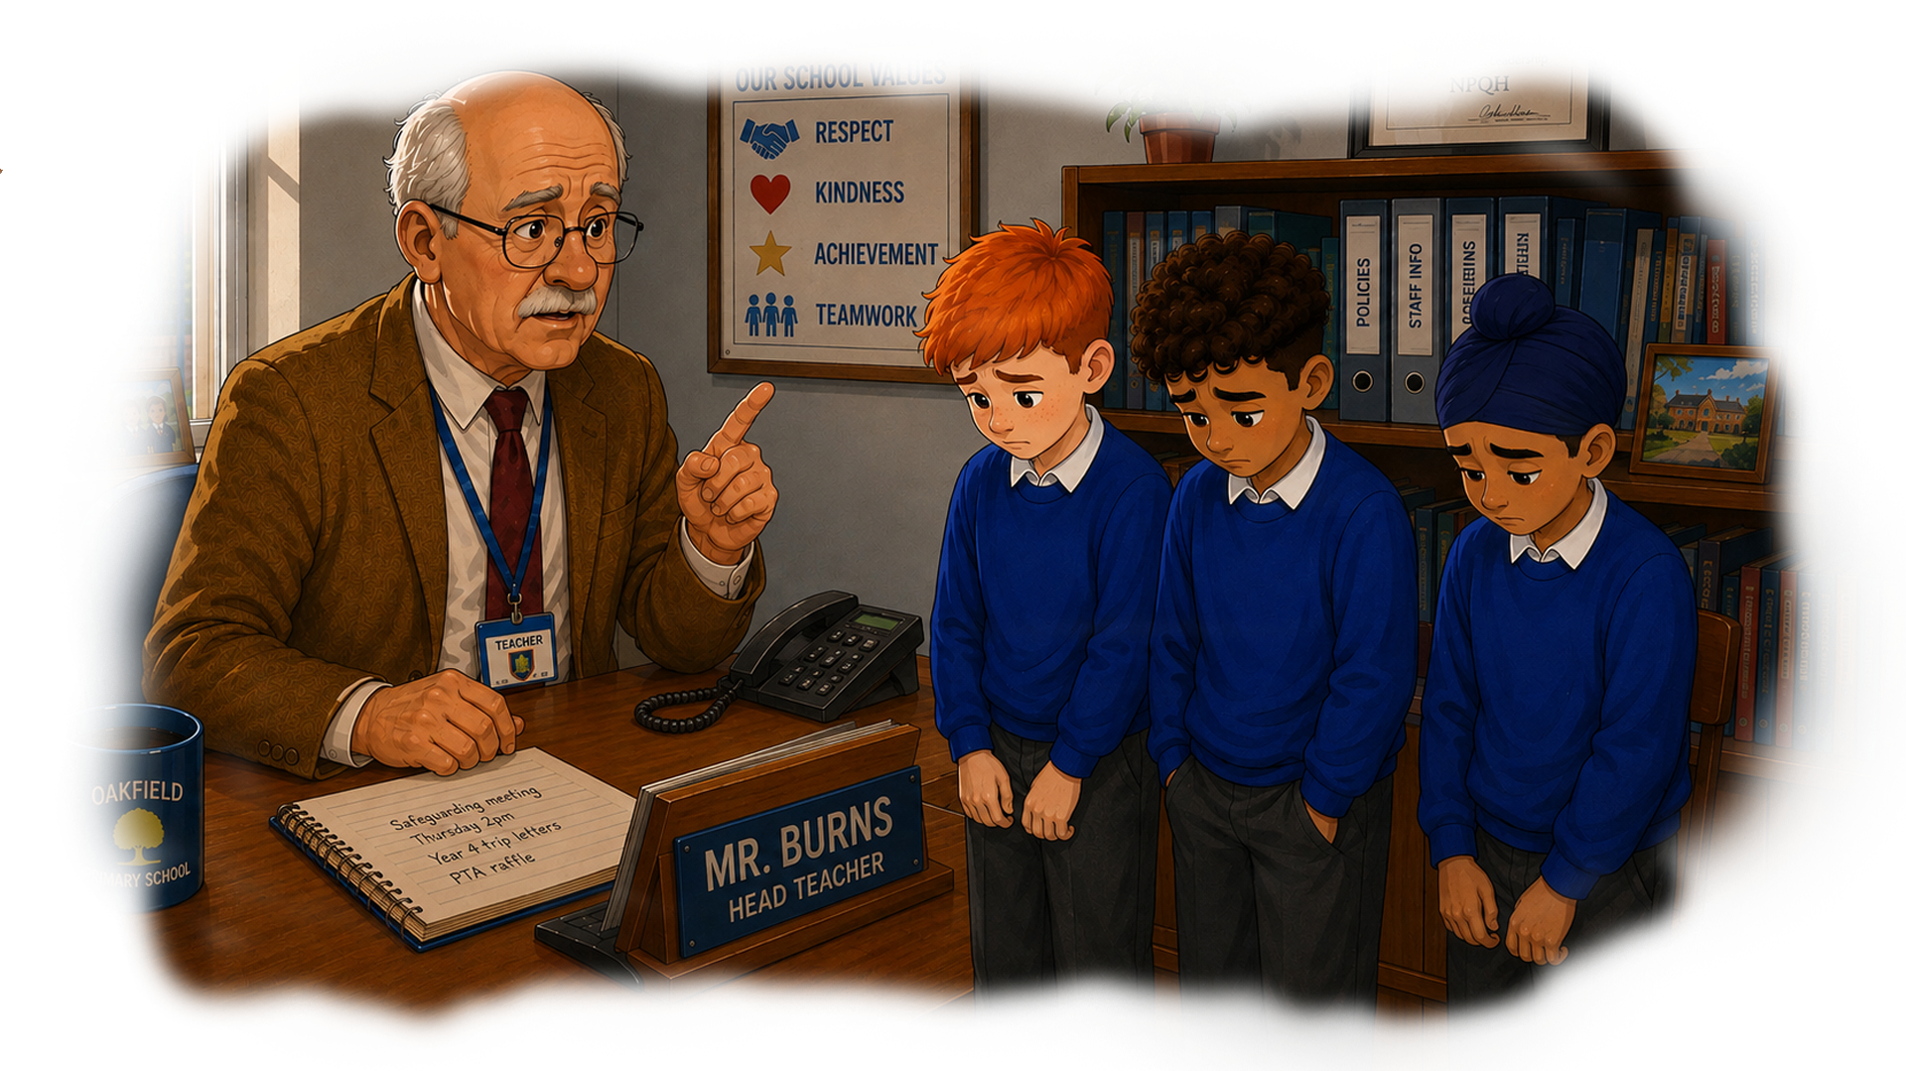
Mr Burns speaks to the boys, he explains the danger of running across roads,
“a driver may not see you coming and not be able to stop in time. You might be badly hurt.
I am going to get our school’s Police Officer to come to talk to everyone,
about how we can all cross the roads safely.”

Slide 10
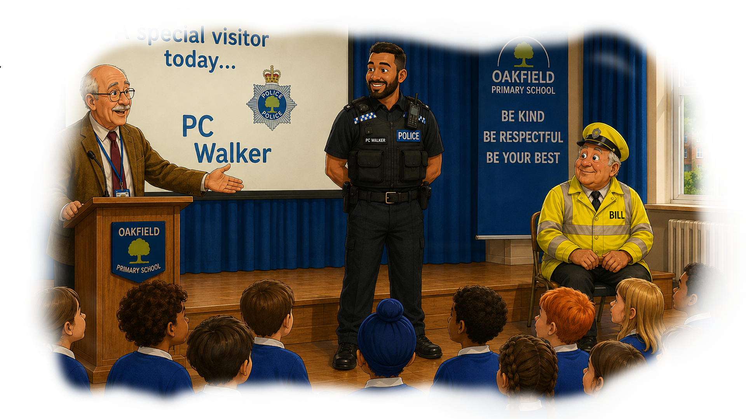
PC Walker is standing on the stage, in front of the school. Bill is sitting at the side.
Mr Burns is smiling, he tells the children in the school assembly,
“PC Walker is here to help us all know more about keeping safe, when we cross the road.”

Slide 11
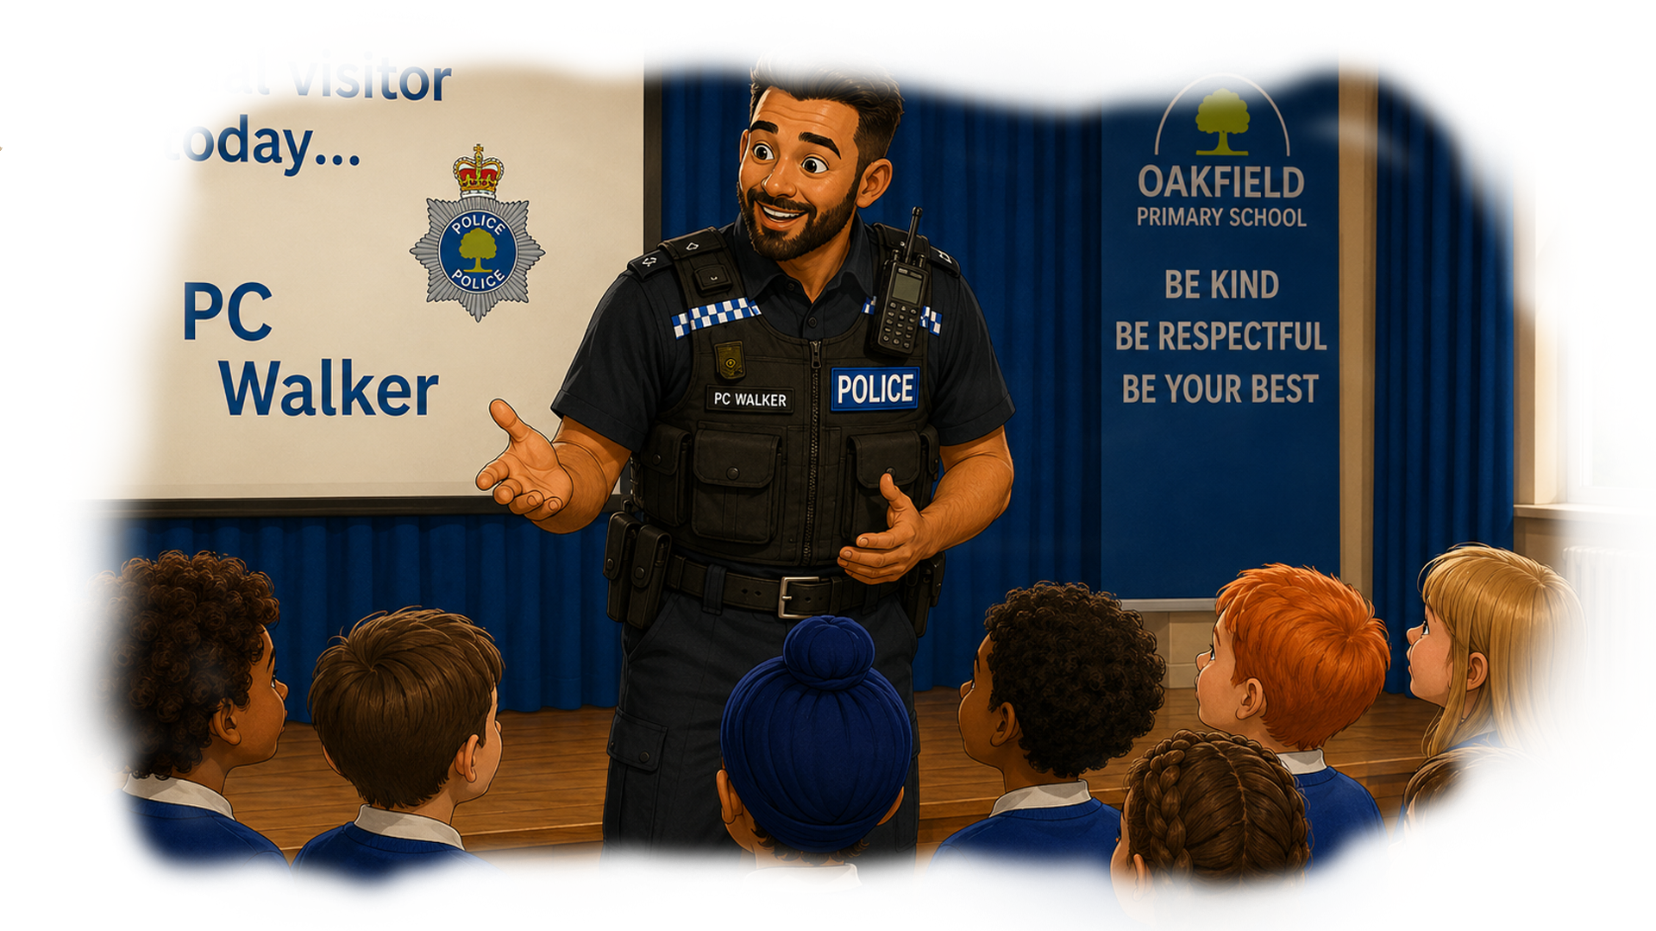
“You are all lucky to have Bill helping you cross the road at the start and end of each day.
I am here to talk to you about how to cross roads safely at other times of the day.
Can someone tell me when you might want to cross the road?”
A girl puts her hand up and says “if you want to go to the shops or the park.”

Slide 12
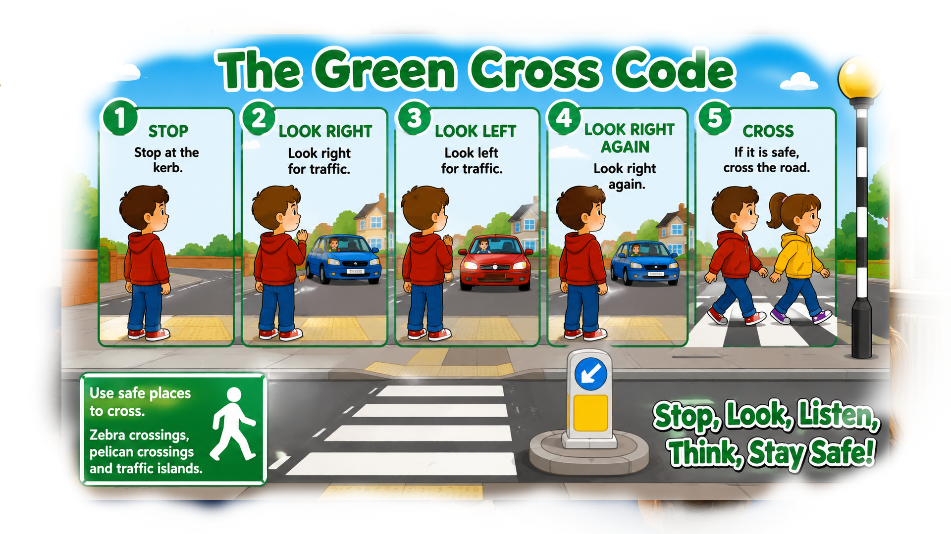
PC Walker shows them a picture on the screen
“There are lots of times when you need to cross the road.
The Green Cross Code helps you to do so safely. You need to stop, look, listen, and wait.”

Slide 13
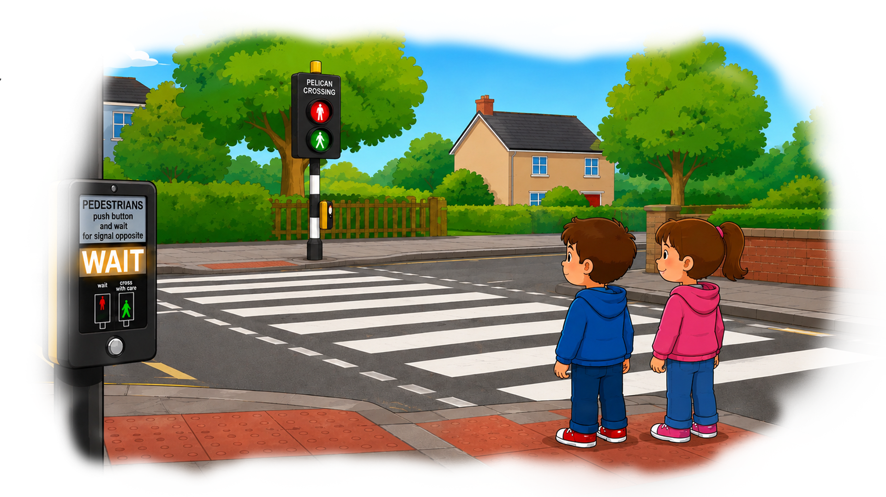
“When you stop, and look, you might see black and white markings on the road.
These tell you that they are a safe place to cross.
Some have buttons you can press to tell you when it is safe to cross.
You still need to stop, look, listen, and wait, till it is safe to cross.”

Slide 14
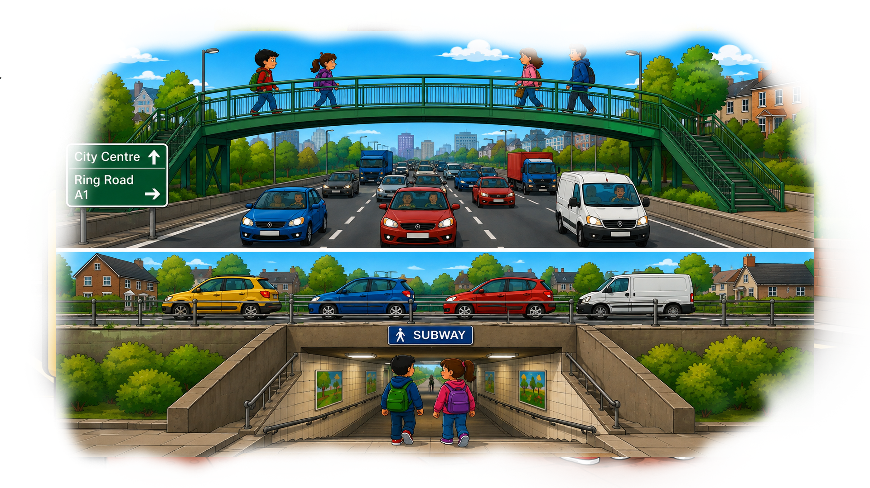
“ It is not safe to try to cross roads which are much wider and have lots of traffic.
When you stop and look, you might see a road bridge or a subway.
They are there to provide you with a safe way to cross the road.
Always use these if they are there.”

Slide 15
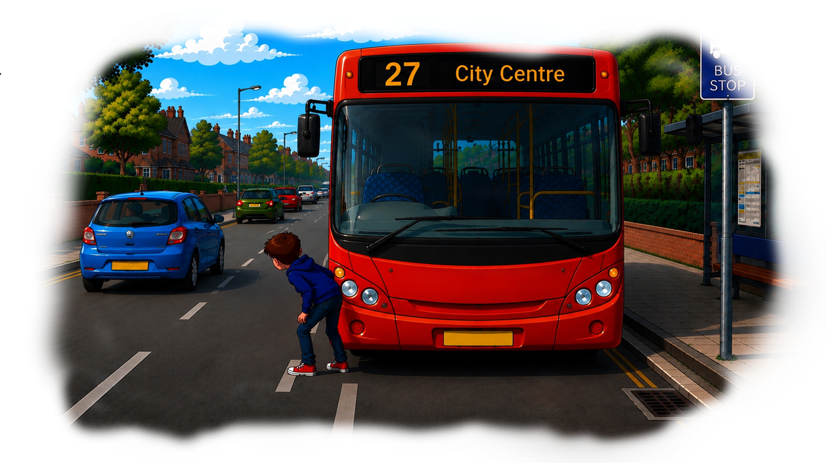
“On all roads, always make sure you can see the traffic,
don’t step into the road from behind a car or a bus,
you won’t see the cars and they won’t see you.”

Slide 16
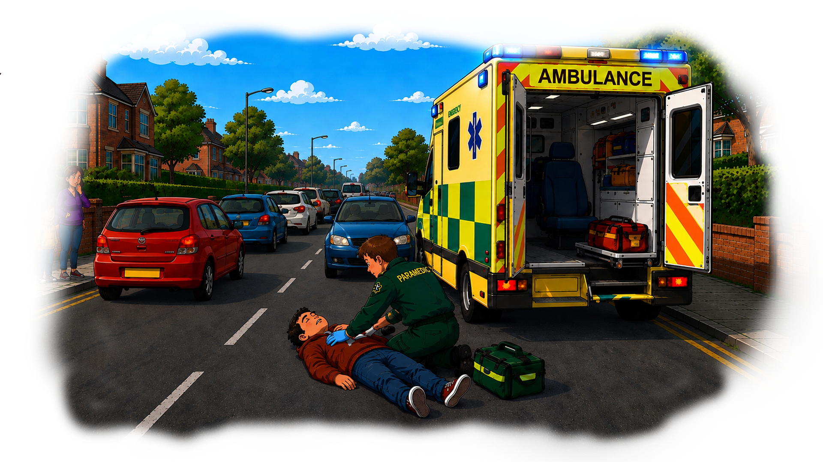
“Make sure you are always looking and listening as you cross,
so you see or hear cars which are turning or over-taking other cars.
If you are talking to your friends or looking at your phone, you could be hit by a car.”

Slide 17
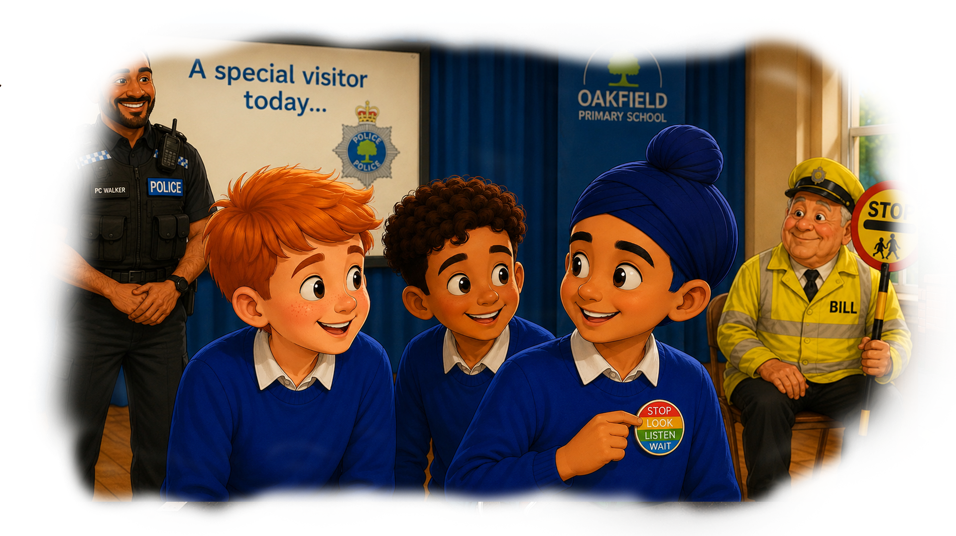
PC Walker finished his talk. He gave out badges for all the children.
The badges had Stop, Look, Listen, and Wait, written on them.
Kiran pinned his badge on his jumper, and grinned at William and Anas.

Slide 18
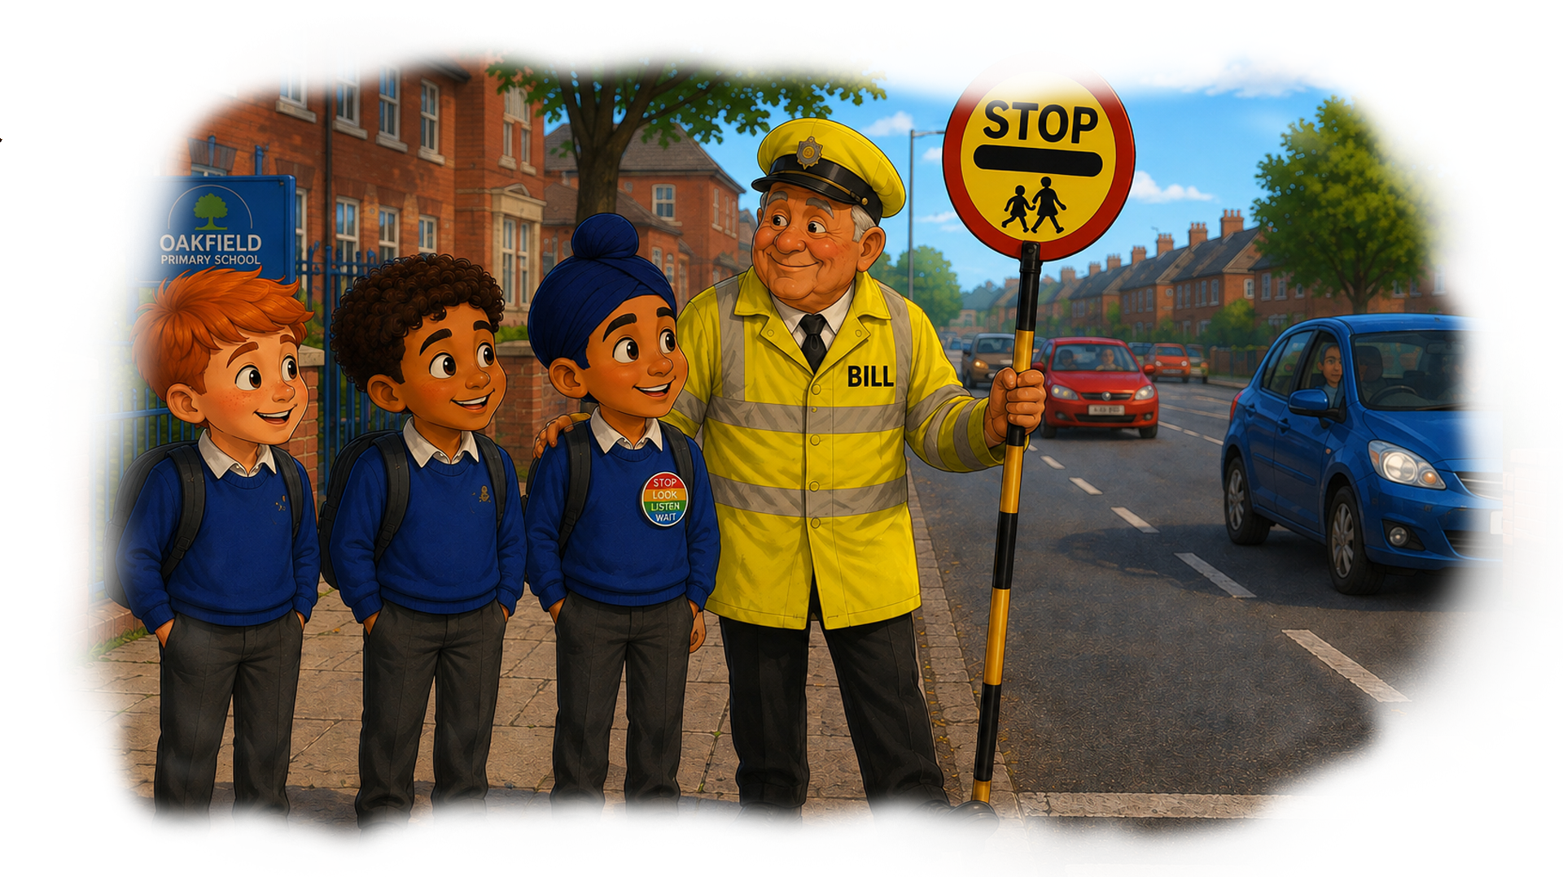
The next morning, the boys were standing by Bill waiting to cross to school.
Bill smiled at them and quietly said “well done lads.”
When Bill saw a gap in the traffic, he stepped out into the road and put up his stop sign,
so they could cross safely.

Slide 19
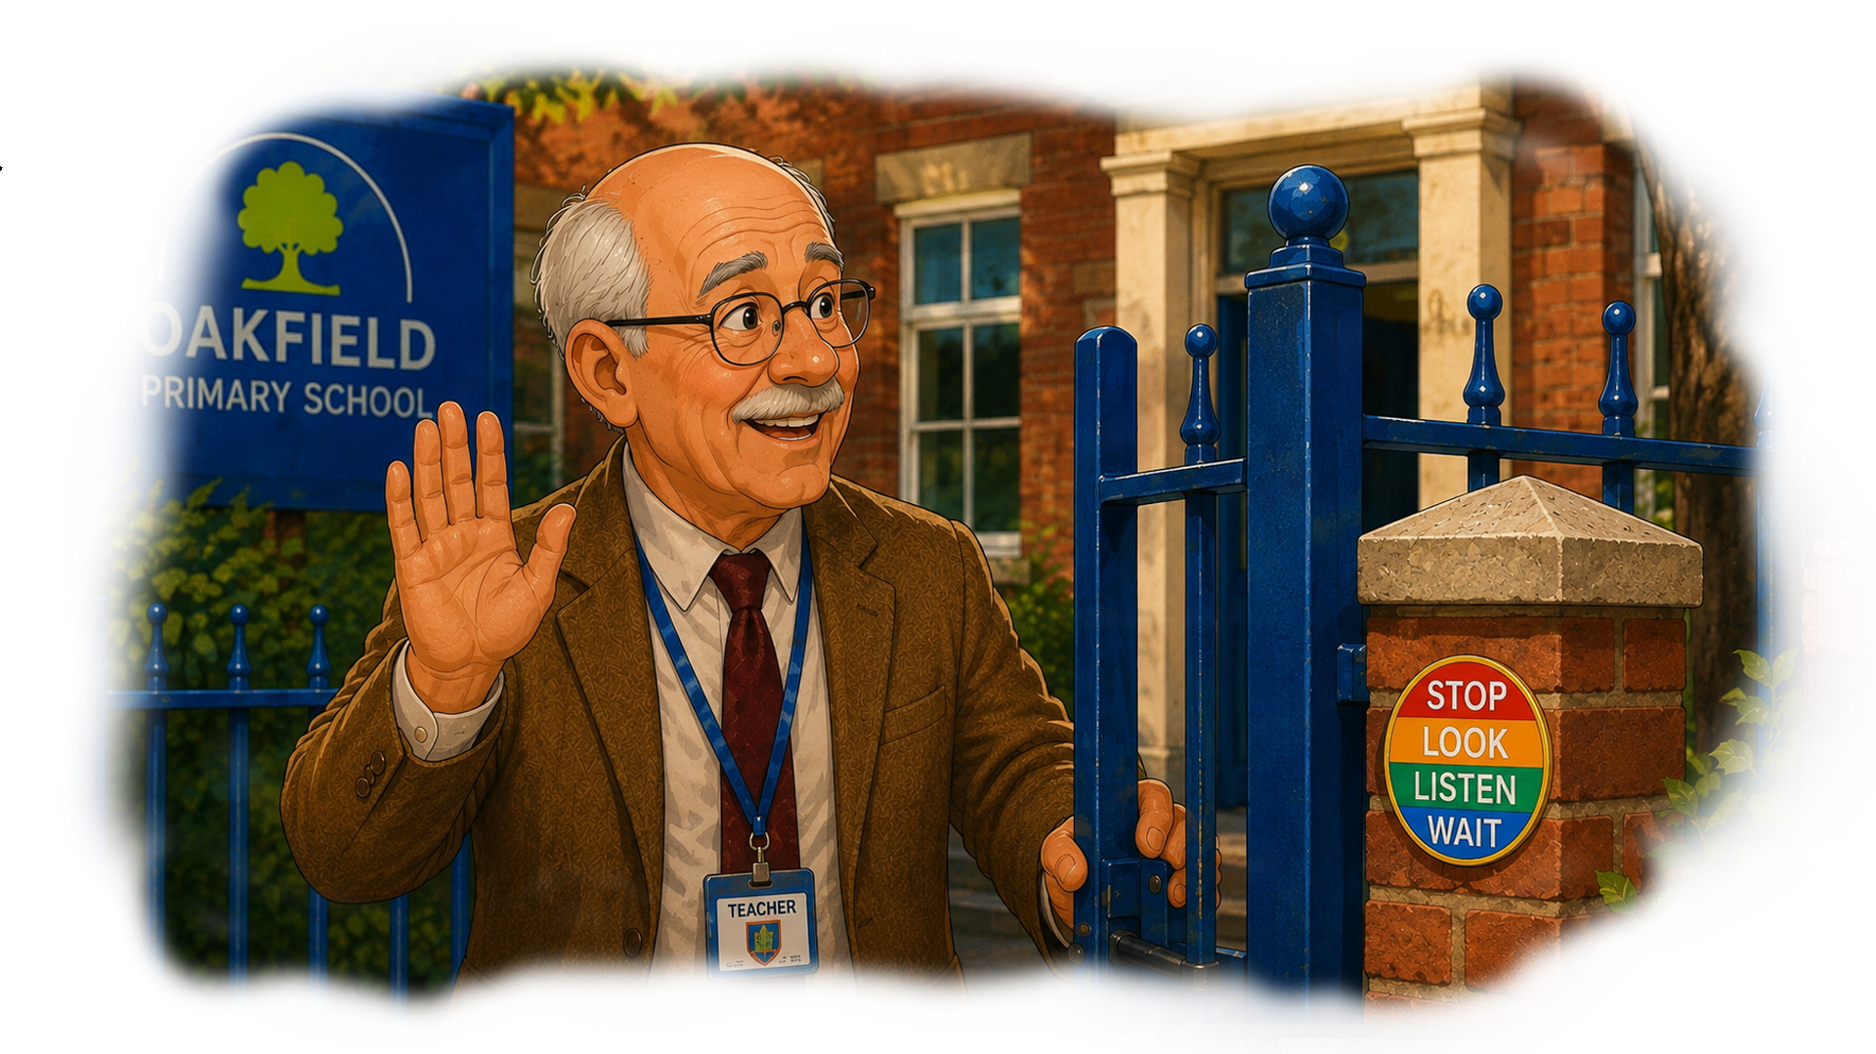
When the bell goes, Mr Burns comes out to close the school gate, and he waves at Bill.
When he notices Bill is wearing a stop, look, listen, and wait, badge, he laughs to himself.
He thinks “PC Walker did a good job, everybody got the message!”

Slide 20
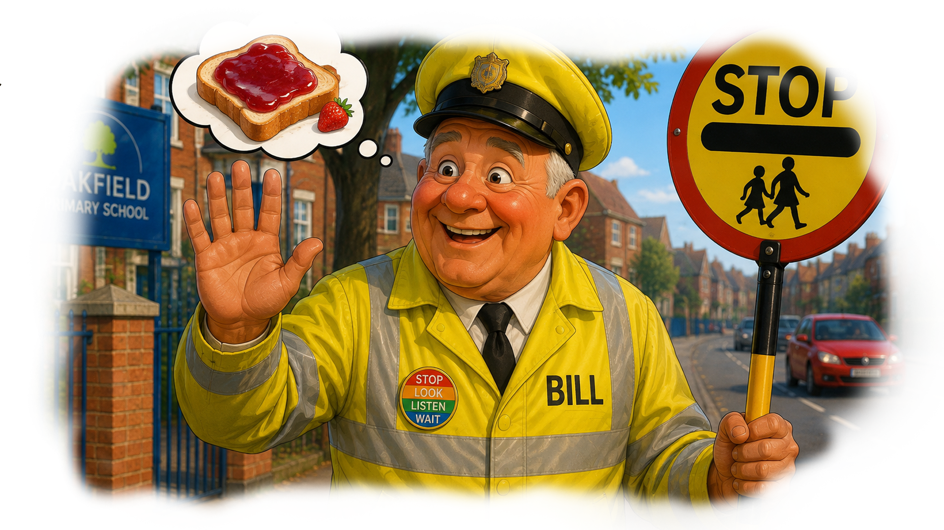
Bill waves back to Mr Burns.
He smiles and turns to walk home.
As he walks, he thinks “I am going to have strawberry jam on my toast today.”

